Slide 1



Science and Technology Reporting
Michelle a. Monroe
Mentor: david wichner, asst. business editor, Arizona Daily star
21st annual arizona space grant consortium symposium
University of Arizona on April 20-21, 2012

Slide 2
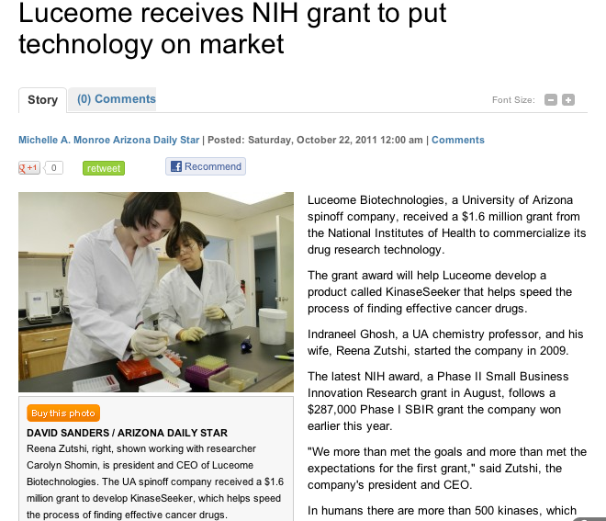

OUTLINE
The reporting process (ideas, interviews, writing)
Writing process
Results and reflections
Story on azstarnet.com

Slide 3
Reporting Process
Generating story ideas
Initial research and readings
Interviewing sources
Follow up phone calls and fact checking

Slide 4
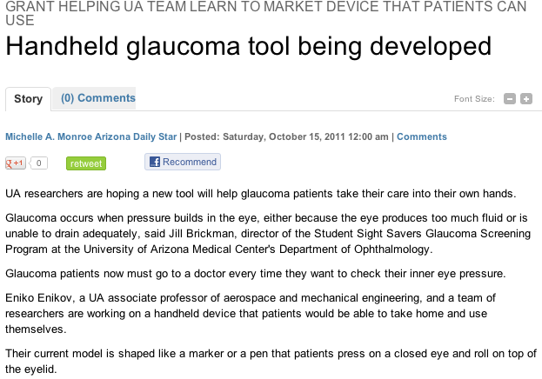
Writing Process
Finding reader interest
“So what?”
Local → global impact
Data versus quotes
Story on azstarnet.com

Slide 5
Results and Reflections
21 articles
Source list
Differences in science writing versus other types

Slide 6
THANK YOU!
Stories and photos can be found at azstarnet.com

